Slide 1

European Employment Dataset Analysis
By: Diego A. Rodriguez

Slide 2
Contents
The Dataset
European Employment Dataset
Sample of the European Employment Dataset
The Analysis
What is the objective?
Resources and Tools
The Results
A Glimpse at the results
The Conclusion
Final Notes

Slide 3

The Dataset

Slide 4
European Employment Dataset
Percentages of the workforce employed in nine different industry groups in 30 countries in Europe separated by groups: EFTA, EU, Eastern, Other.
AGR, agriculture, forestry, and fishing; MIN, mining and quarrying; MAN, manufacturing; PS, power and water supplies; CON, construction; SER, services; FIN, finance; SPS, social and personal services; TC, transport and communications.

Slide 5
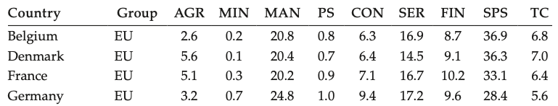
Sample
Data from Euromonitor (1995), except for Germany and the United Kingdom, where more recent values were obtained from the United Nations Statistical Yearbook, 2000.

Slide 6

The Analysis

Slide 7
What are we trying to show?
Our main objective is to find out what industry different European countries focus their resources.

Slide 8
Tools and Resources
All the analysis will be completed using R Studio.

Slide 9

Results

Slide 10
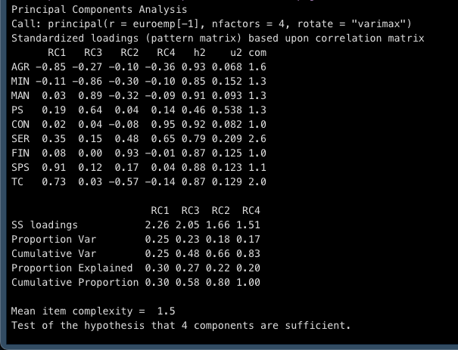
Principal Components Analysis
Based on our analysis, we only need to focus on 4 components of analysis.
Notice how component RC1 is loaded negatively with ARG component, and positively loaded with SPS.
Countries with RC1 rely on private services and not on agriculture.

Slide 11
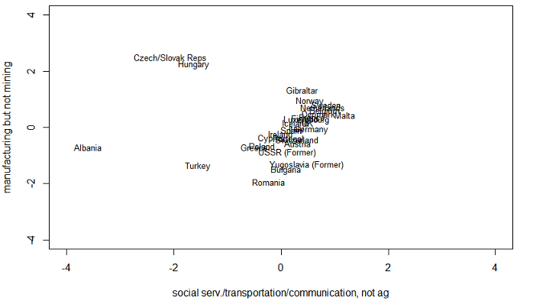
Comparing Factor 1 to Factor 2
Here we can see the countries that focus on services but not agriculture are clustered together to the right and middle of the graph.
Also, on the y axis, we see the countries that focus on manufacturing and not mining.

Slide 12
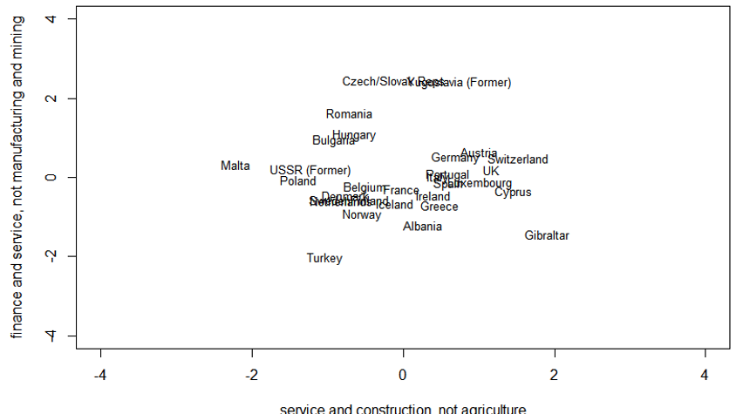
Comparing Factor 3 and Factor 4
Here we can distinguish between countries that rely on construction and finance and services.

Slide 13
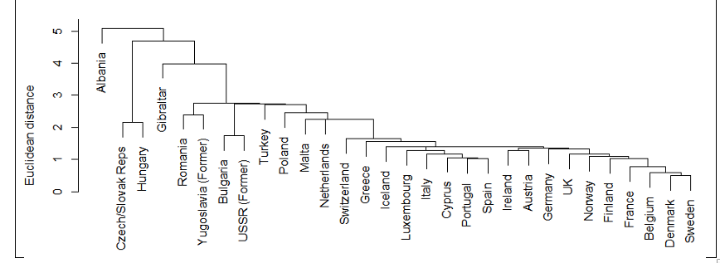
Final Groupings
Here we have the final groupings.
With exceptional cases like Albania and Gibraltar: we can notice how EU and EFTA countries align with each other just like former soviet and eastern countries do.

Slide 14
Conclusions.
By the cluster and component analysis, we can see that Eastern and Other countries rely mostly on agriculture and mining while EU and EFTA countries have moved into all types of services and different technologies.

Slide 15
Notes
The analysis was made with only 4 clusters in mind. A more accurate results might have been obtained if we used more clusters.
Only relevant analysis are presented since Levene’s, Hotelling’s, Distance and more analysis were made but are not relevant to the presentation.

